Slide 1

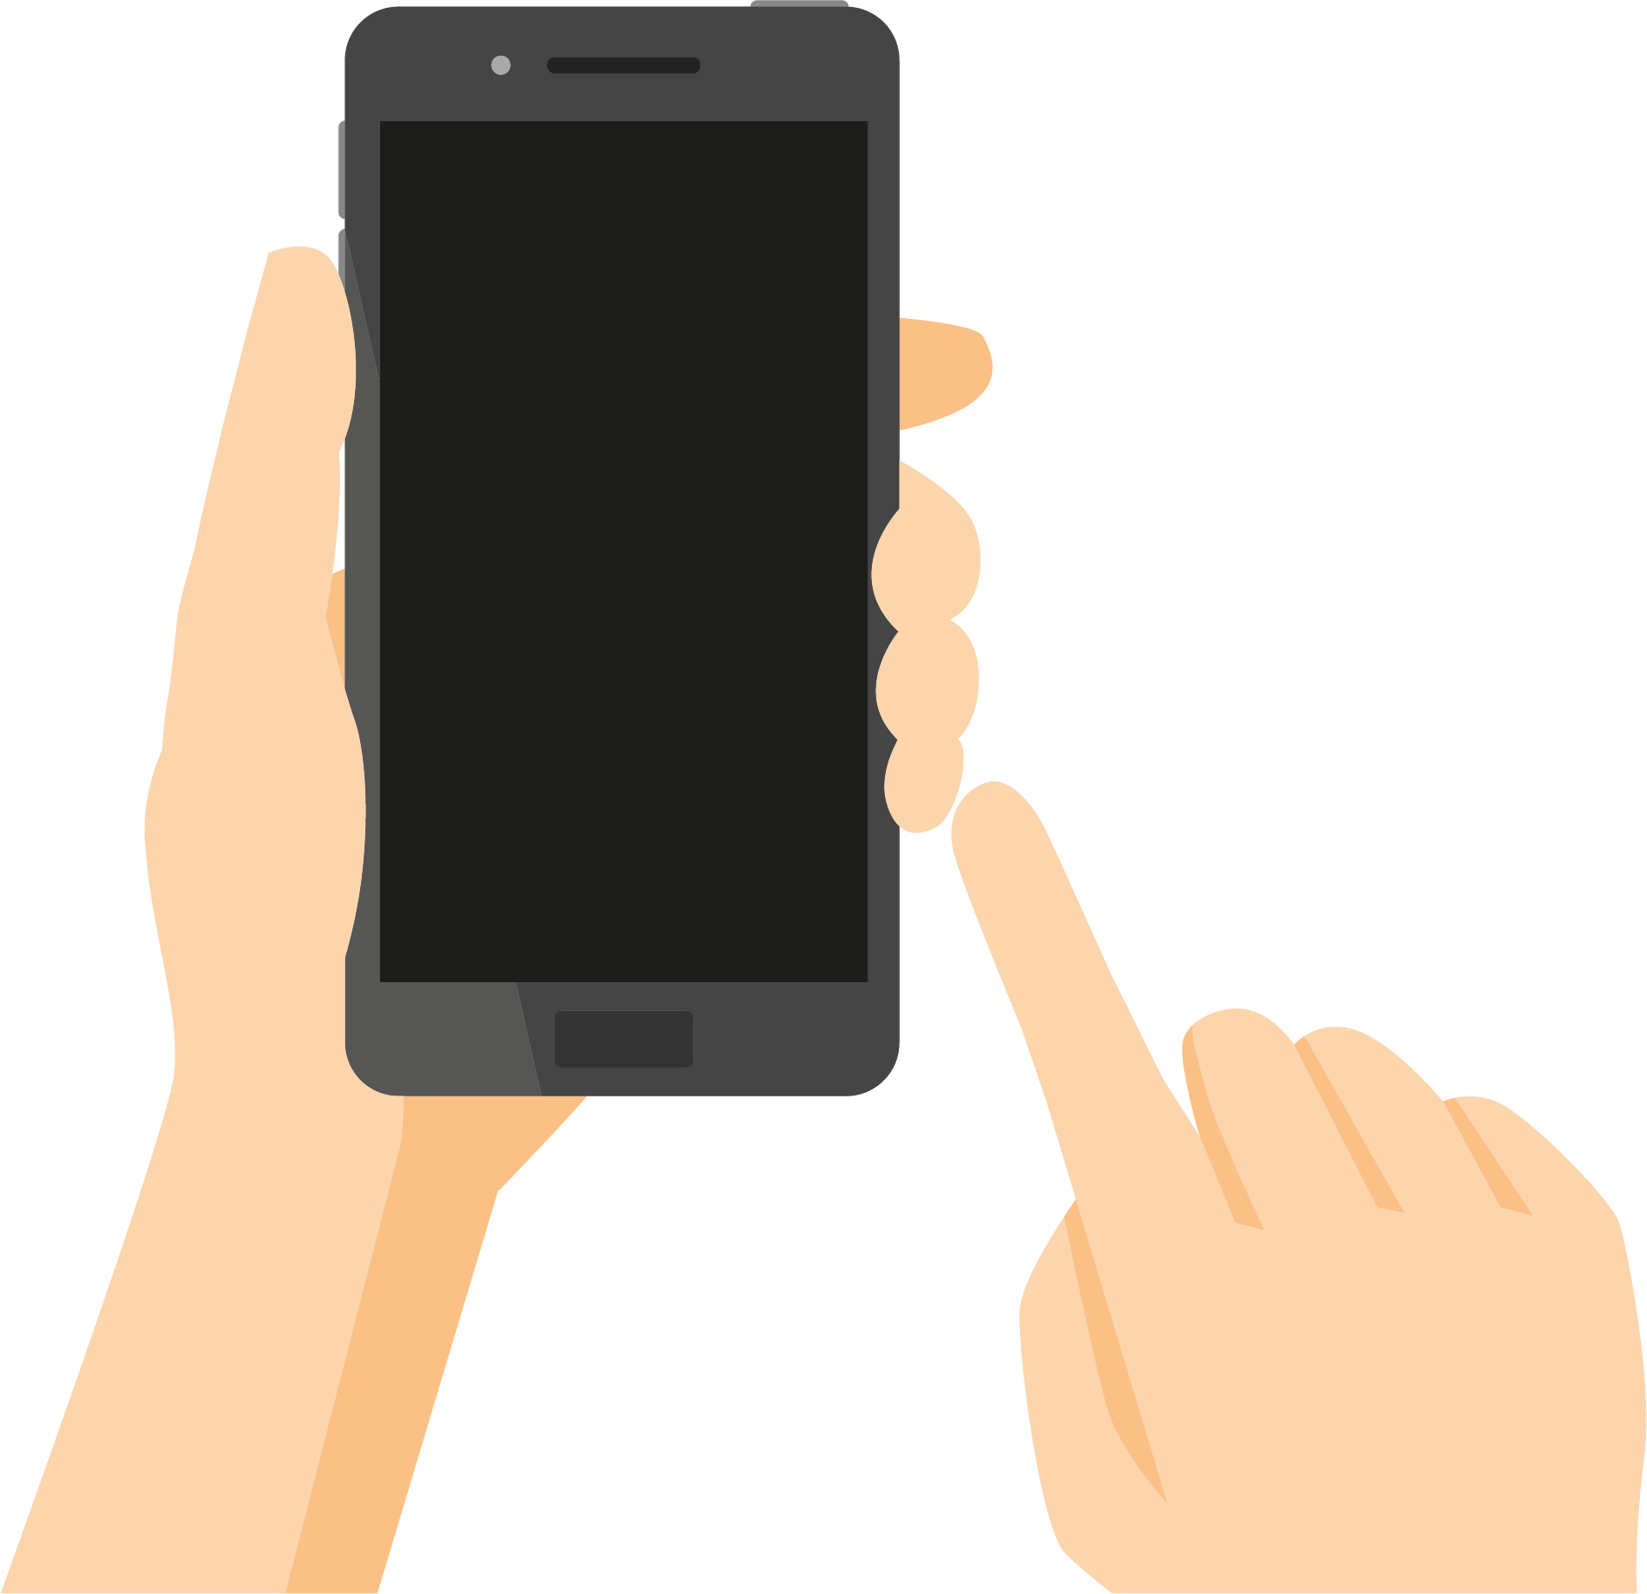




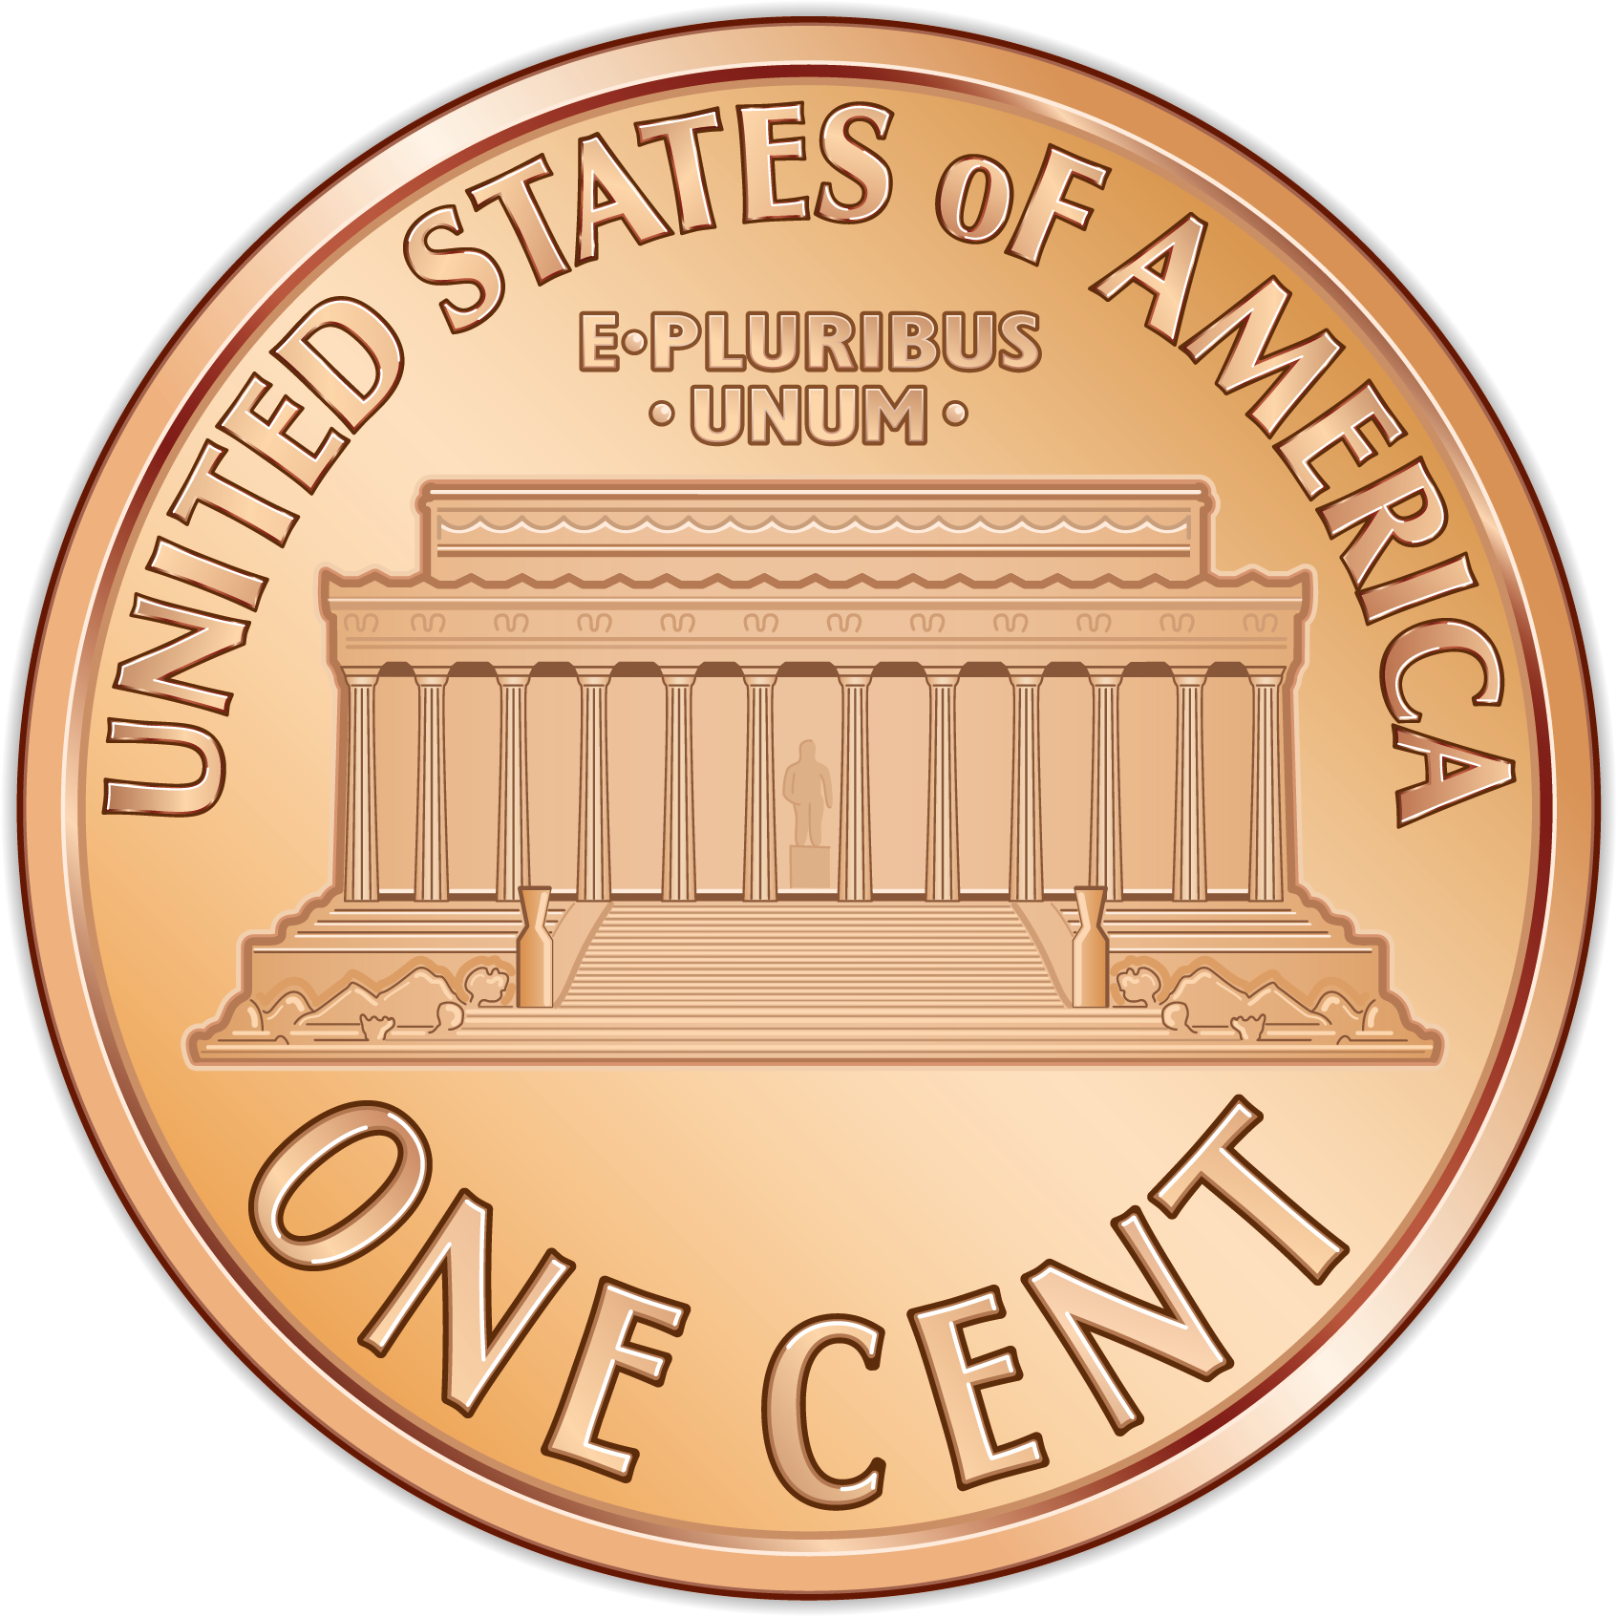





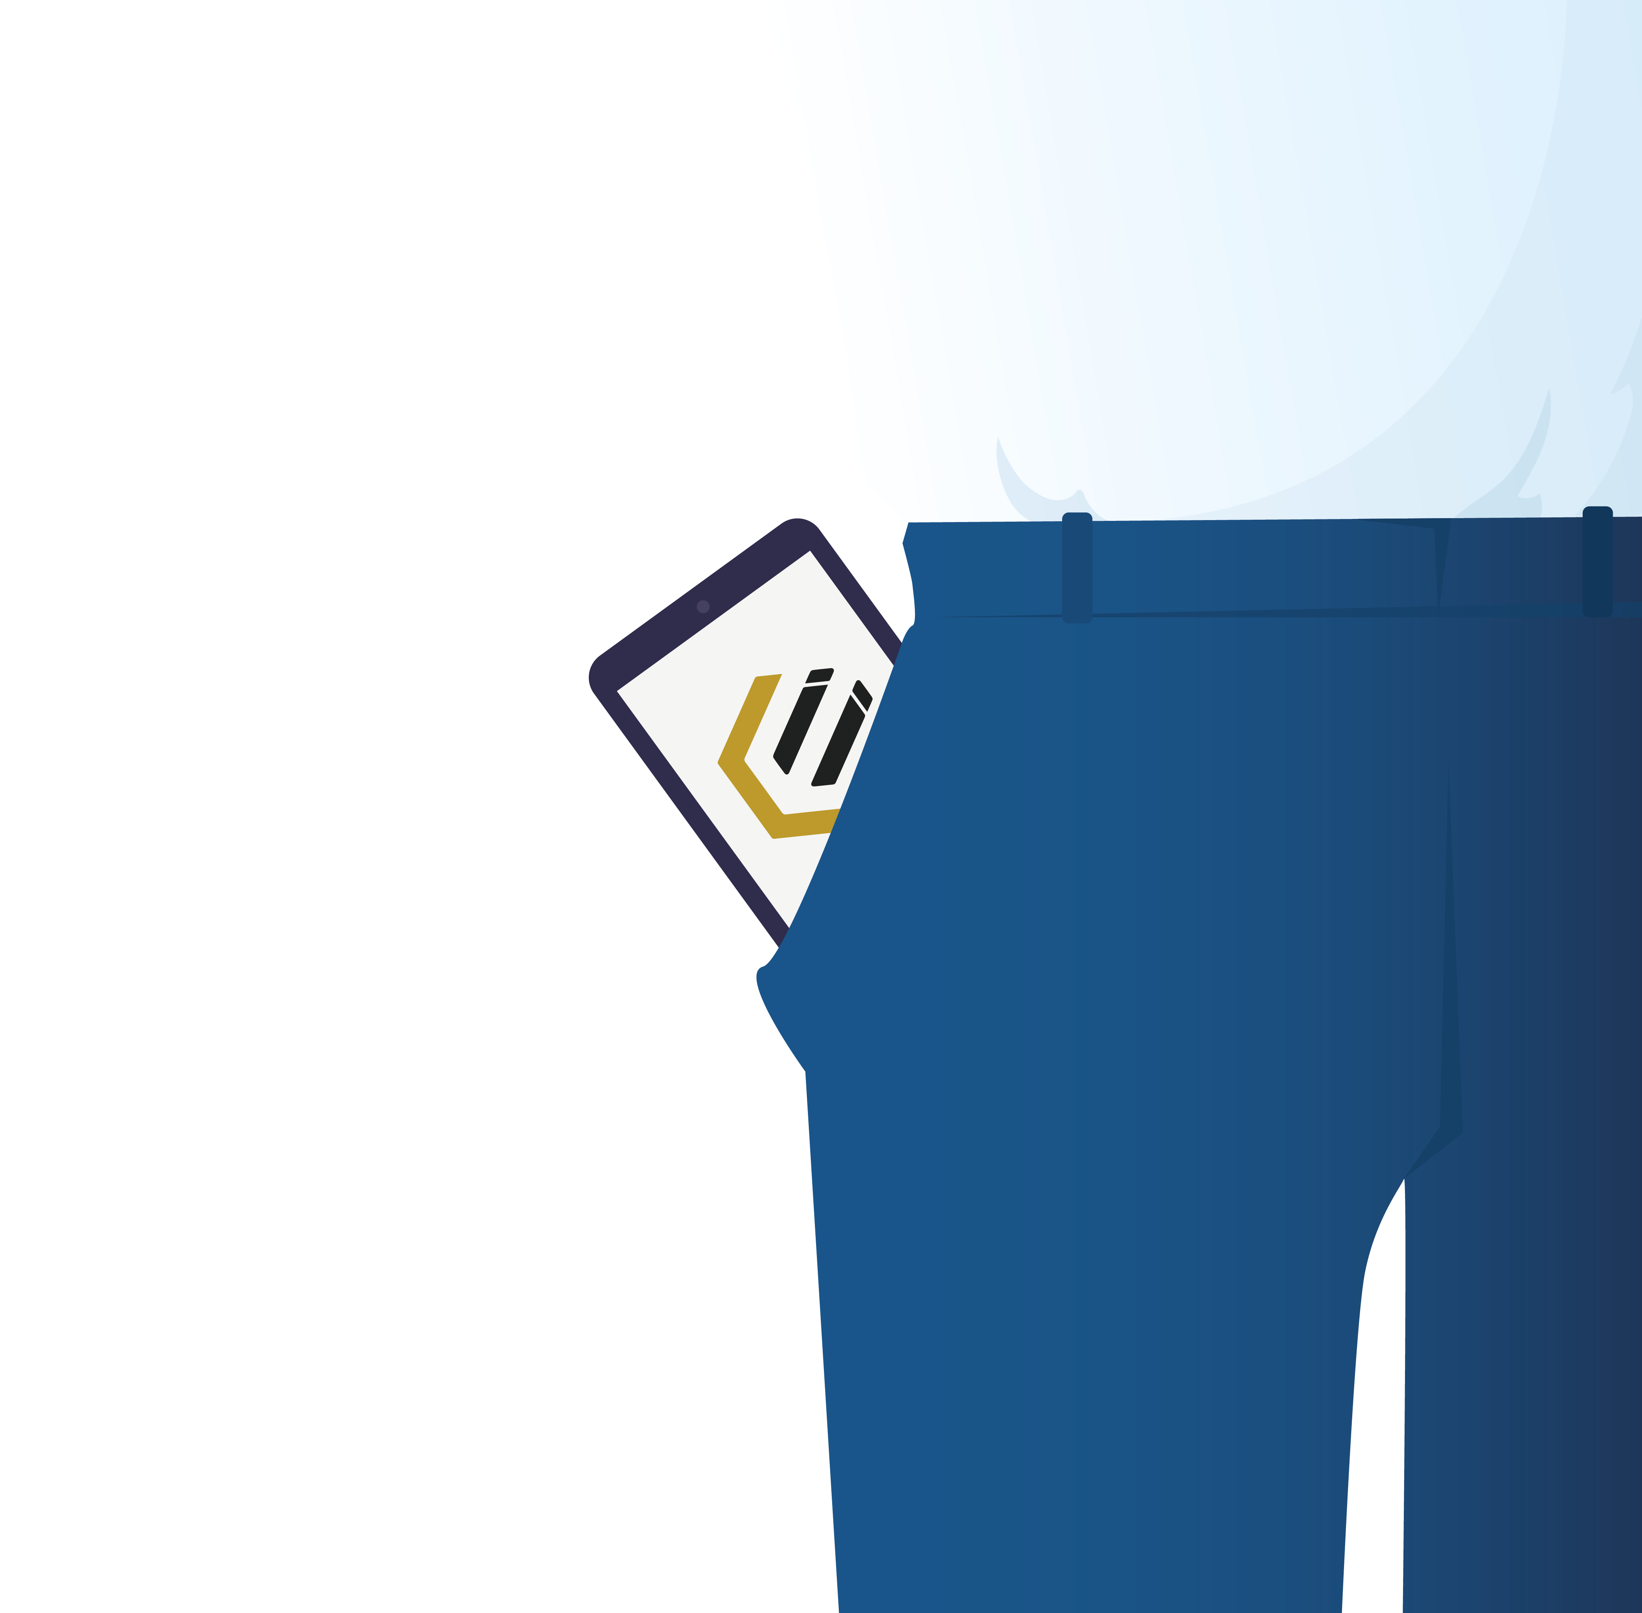


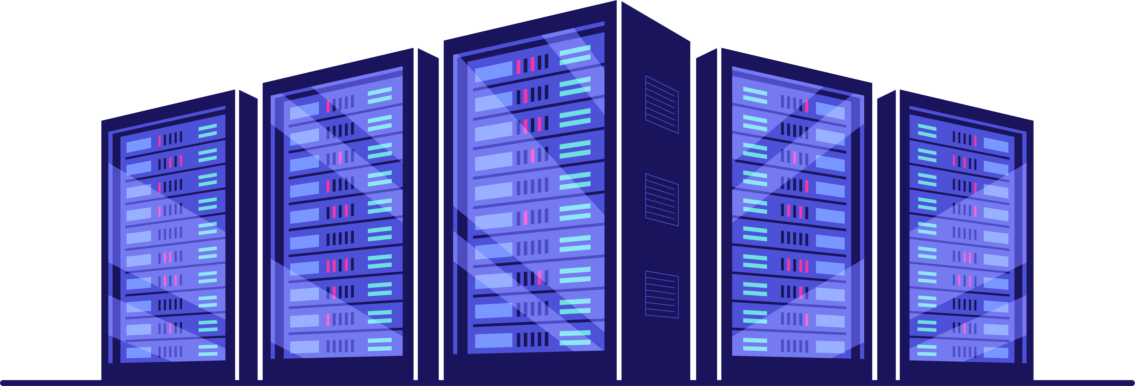
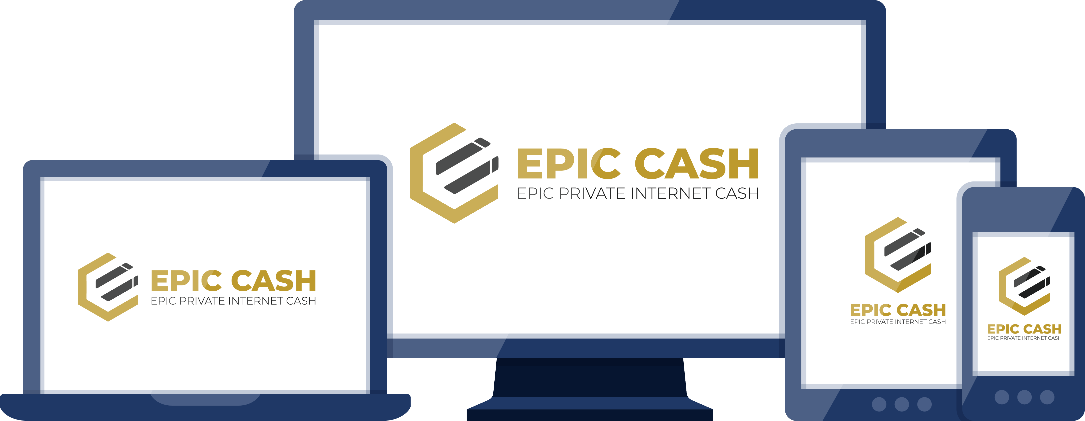
YOU DON’T STILL USE A VINTAGE CELL PHONE FROM 2009, WHY USE A NOSTALGIC BLOCKCHAIN?
DISK SPACE REQUIRED
280GB
1.3GB
TRANSACTIONS
$25
1/40TH
¢
10 MINUTES
1 MINUTE
THROUGHPUT
5
15
TRANSACTIONS PER SECOND
TRANSACTIONS PER SECOND
PRIVACY
20
1
0
STEPS
HOUR
STEPS
INSTANT
MOBILE
TRUST VARIOUS 3RD PARTIES TO RUN ON MOBILE
CAN FIT ENTIRE SYSTEM IN YOUR POCKET
MINING
ONLY ON SPECIALIST EQUIPMENT (MAINLY IN DATA CENTERS)
ON ORDINARY COMPUTERS (FOR EVERYONE)
V05, Feb 2021

